Slide 1
Cordless Systems and Wireless Local Loop

Slide 2
Cordless System Operating Environments
Residential – a single base station can provide in-house voice and data support
Office
  A single base station can support a small office
  Multiple base stations in a cellular configuration can support a larger office
Telepoint – a base station set up in a public place, such as an airport

Slide 3
Design Considerations for Cordless Standards
Modest range of handset from base station, so low-power designs are used
Inexpensive handset and base station, dictating simple technical approaches
Frequency flexibility is limited, so the system needs to be able to seek a low-interference channel whenever used

Slide 4
Time Division Duplex (TDD)
TDD also known as time-compression multiplexing (TCM)
Data transmitted in one direction at a time, with transmission between the two directions
  Simple TDD
  TDMA TDD

Slide 5
TDMA TDD
Wireless TDD typically used with TDMA
  A number of users receive forward channel signals in turn and then transmit reverse channel signals in turn, all on same carrier frequency
Advantages of TDMA/TDD:
  Improved ability to cope with fast fading
  Improved capacity allocation

Slide 6
Wireless Local Loop
Wired technologies responding to need for reliable, high-speed access by residential, business, and government subscribers
  ISDN, xDSL, cable modems
Increasing interest shown in competing wireless technologies for subscriber access
Wireless local loop (WLL)
  Narrowband – offers a replacement for existing telephony services
  Broadband – provides high-speed two-way voice and data service

Slide 7
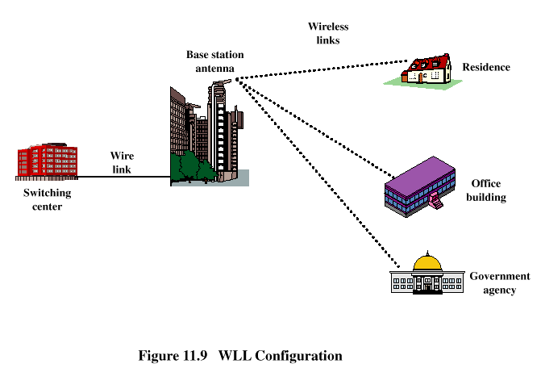
WLL Configuration

Slide 8
Advantages of WLL over Wired Approach
Cost – wireless systems are less expensive due to cost of cable installation that’s avoided
Installation time – WLL systems can be installed in a small fraction of the time required for a new wired system
Selective installation – radio units installed for subscribers who want service at a given time
  With a wired system, cable is laid out in anticipation of serving every subscriber in a given area

Slide 9
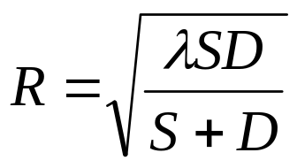
Fresnel Zone
How much space around direct path between transmitter and receiver should be clear of obstacles?
  Objects within a series of concentric circles around the line of sight between transceivers have constructive/destructive effects on communication
For point along the direct path, radius of first Fresnel zone:
    S = distance from transmitter
    D = distance from receiver

Slide 10
Atmospheric Absorption
Radio waves at frequencies above 10 GHz are subject to molecular absorption
  Peak of water vapor absorption at 22 GHz
  Peak of oxygen absorption near 60 GHz
Favorable windows for communication:
  From 28 GHz to 42 GHz
  From 75 GHz to 95 GHz

Slide 11
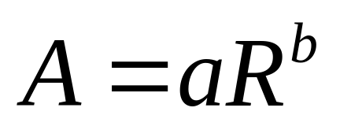
Effect of Rain
Attenuation due to rain
  Presence of raindrops can severely degrade the reliability and performance of communication links
  The effect of rain depends on drop shape, drop size, rain rate, and frequency
Estimated attenuation due to rain:
    A = attenuation (dB/km)
    R = rain rate (mm/hr)
    a and b depend on drop sizes and frequency

Slide 12
Effects of Vegetation
Trees near subscriber sites can lead to multipath fading.
Multipath effects from the tree canopy are diffraction and scattering.
Measurements in orchards found considerable attenuation values when the foliage is within 60% of the first Fresnel zone.
Multipath effects highly variable due to wind.

